Slide 1


Slide 2

Honourpoint is India’s only platform dedicated to the fallen heroes of our Armed Forces since 1947 till date. It is an endeavour to ensure that the supreme sacrifices of our soldiers and their families are given their rightful place in our nation’s collective consciousness.

Slide 3

What makes Honourpoint Unique?
Dynamic, expandable memorial pages
--- with contribution from comrades, family members, friends, and colleagues of units/formations
Living, breathing archive of significant events
---in our nation’s course of history
Not location-specific
--- as is the case with physical memorials. Easily accessible from anywhere by all countrymen
Not restricted to any region, war, unit/regiment
— honours all martyrs of the Armed Forces right from 1947 till date

Slide 4
Core Areas of Activity
Honourpoint puts sustained efforts into three core areas:
Area:1
Building online memorial for the martyrs of Armed Forces since 1947
Area: 2
Creating awareness about the contribution of martyrs and their families to the nation
Area:3
Programs for the benefit of the martyrs’ families in collaboration with various partners

Slide 5
Honourpoint's Approach
It is felt that an initiative of this kind has to be citizen driven, if it has to meet its intended objective. Therefore, Honourpoint is not looking for any government support and is engaged in galvanising civil society in this regard.

Slide 6
Major Events
by
Honourpoint

Slide 7

In association with “Ample Missiion”, Mumbai : Nov 2017
Surat, Dec 2017
In association with Maruti Veer Jawan Trust, Surat

Slide 8

In association with “Maruti Veer Jawan Trust”, Surat : Dec 2017
Mumbai, Jan 2018
In association with Lodha Foundation, Mumbai

Slide 9

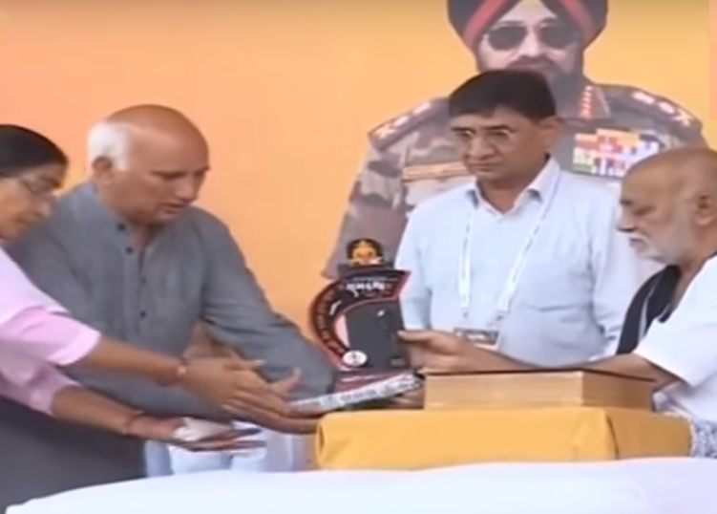
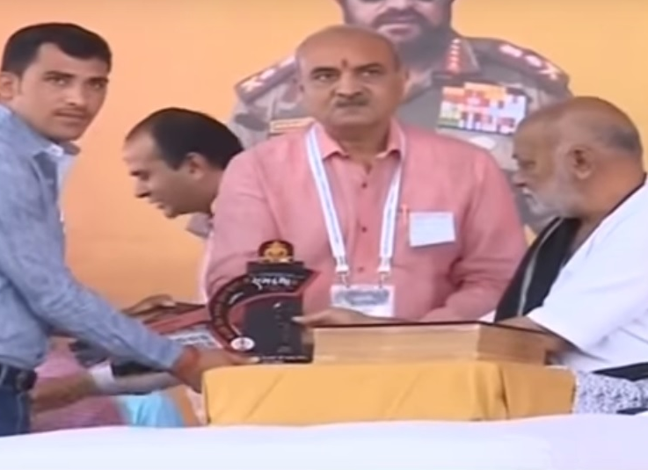
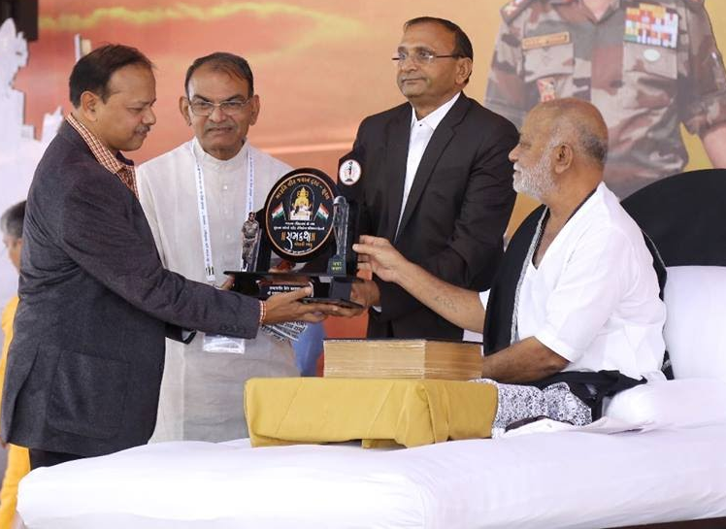
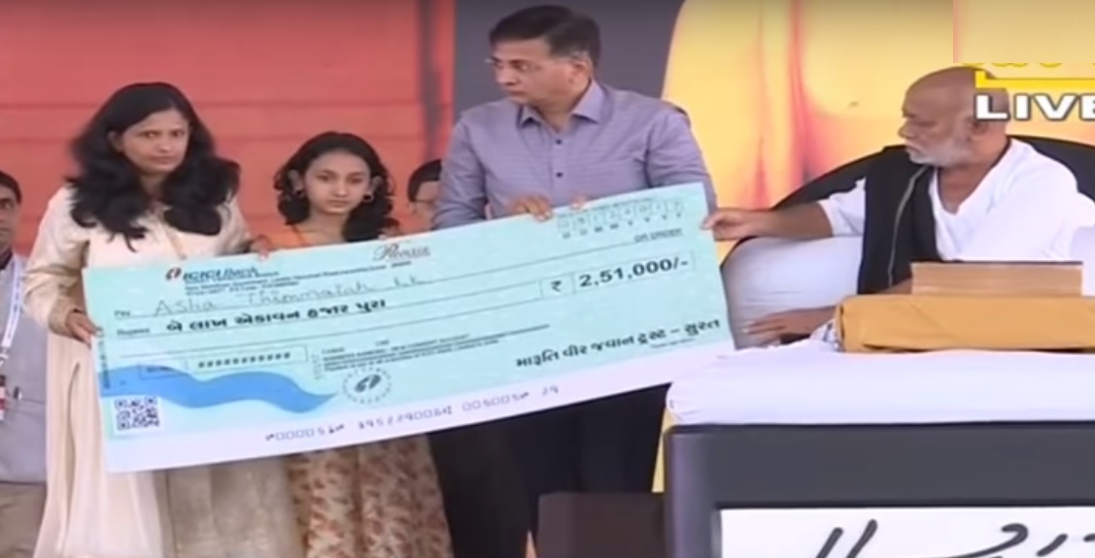
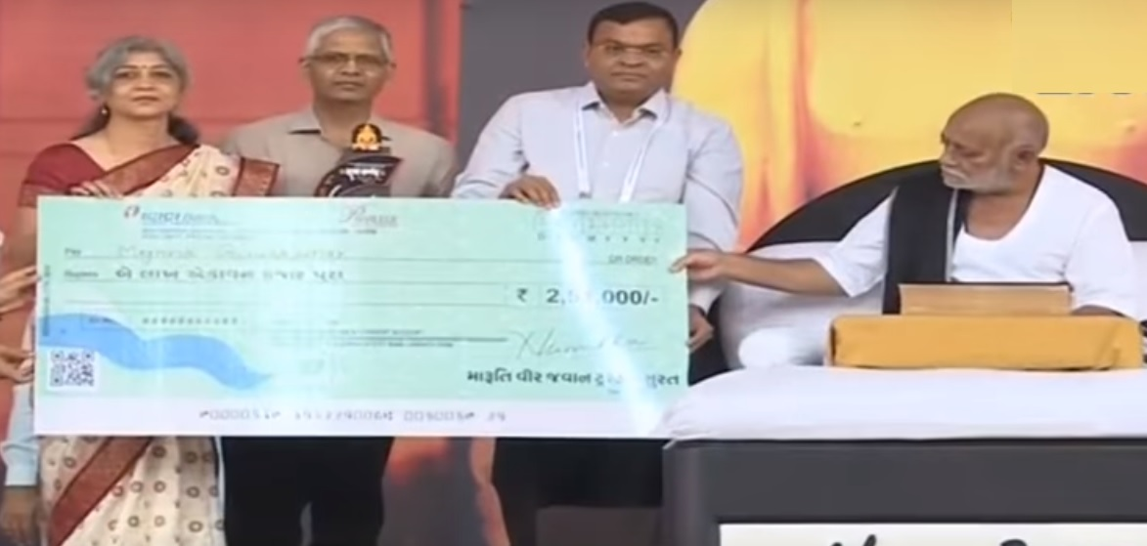
In association with “Lodha Foundation”, Mumbai : Jan 2018

Slide 10

In association with “Lt Kiran Shekhawat Foundation”, Jhunjhunu (Rajasthan) : Mar 2018

Slide 11
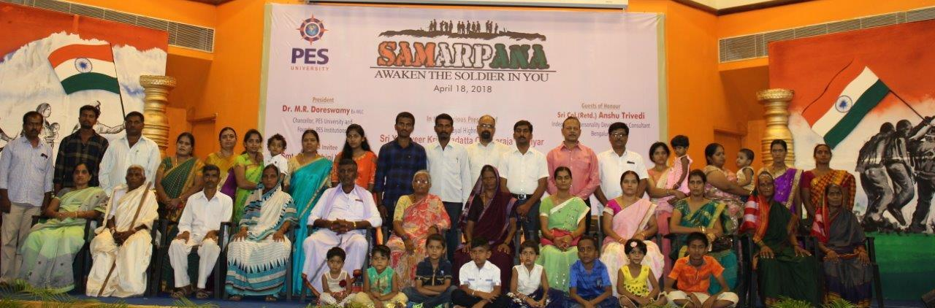
In association with “Samarpana”, Bangalore : April 2018

Slide 12
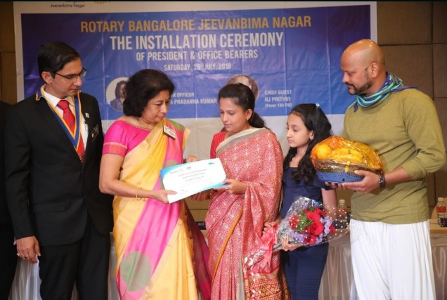
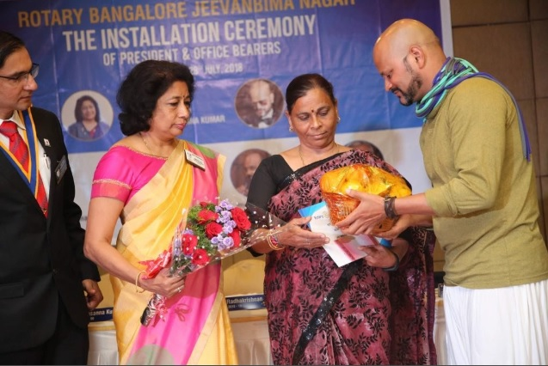
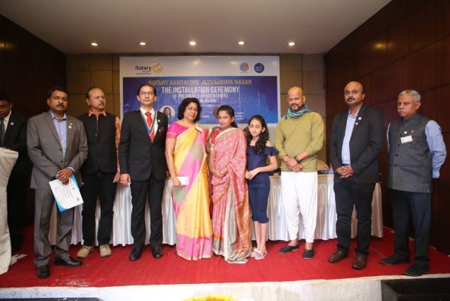
In association with Rotary Club Jeevanbima Nagar, Bangalore: July 2018

Slide 13
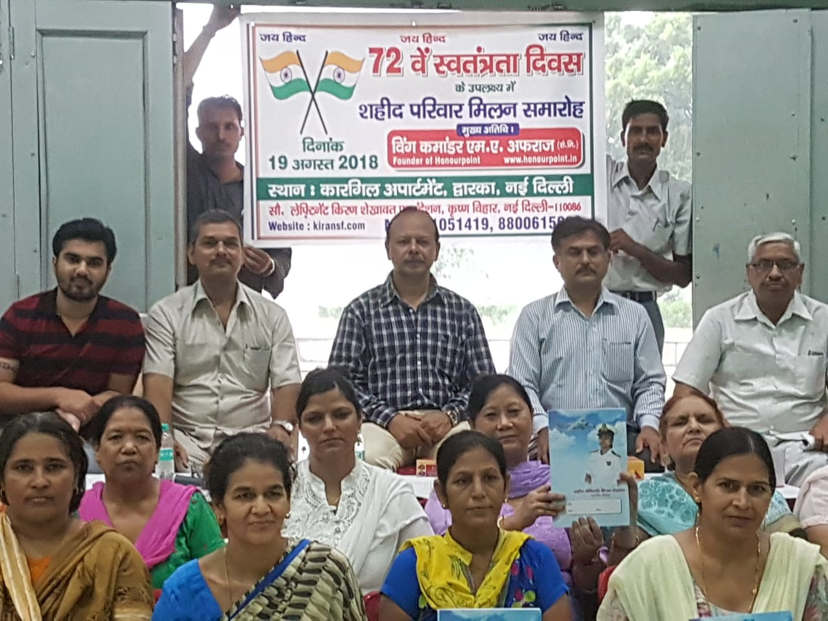
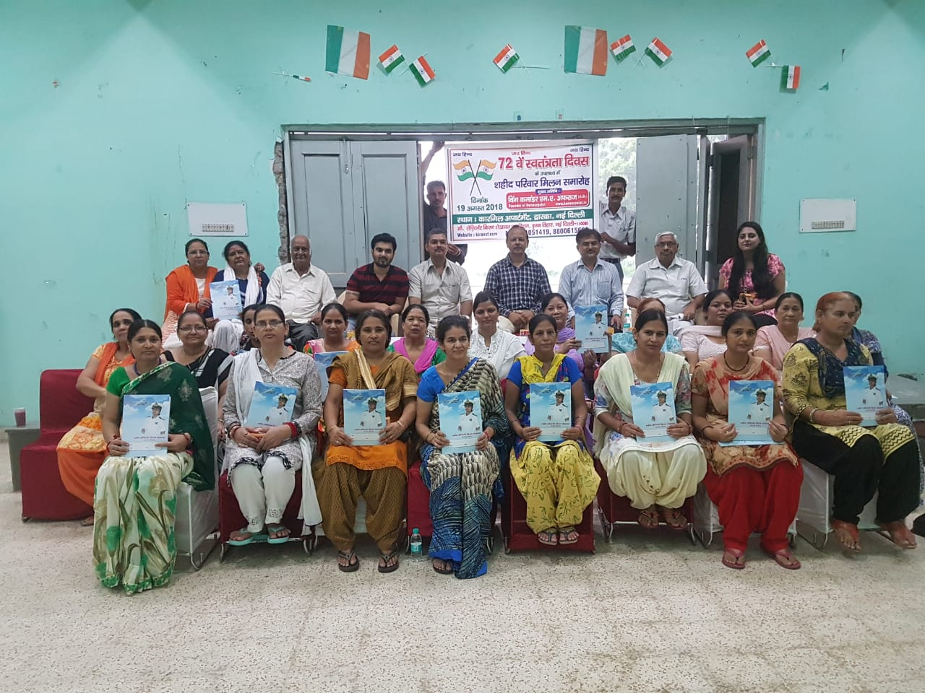
In association with “Lt Kiran Shekhawat Foundation”, Delhi : Aug 2018

Slide 14
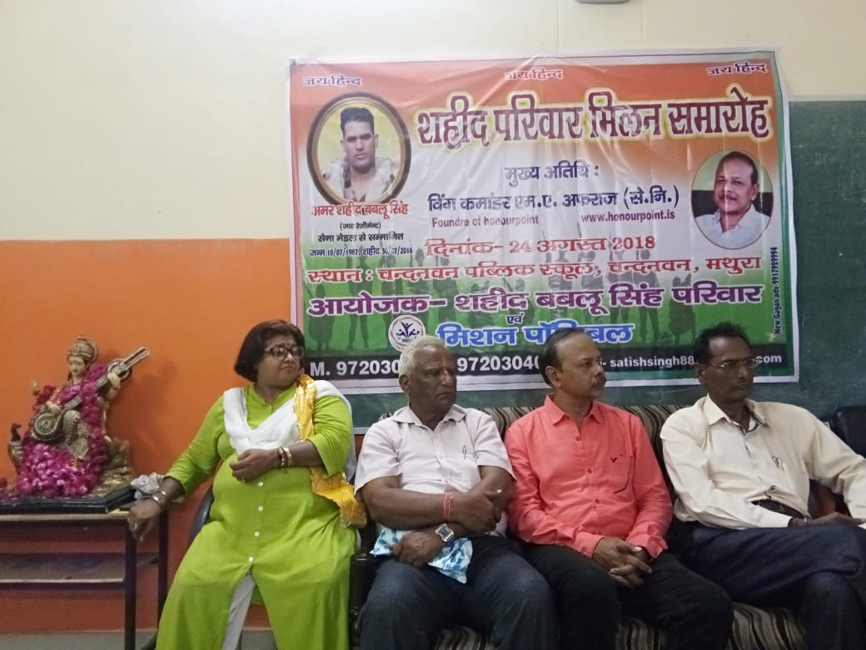
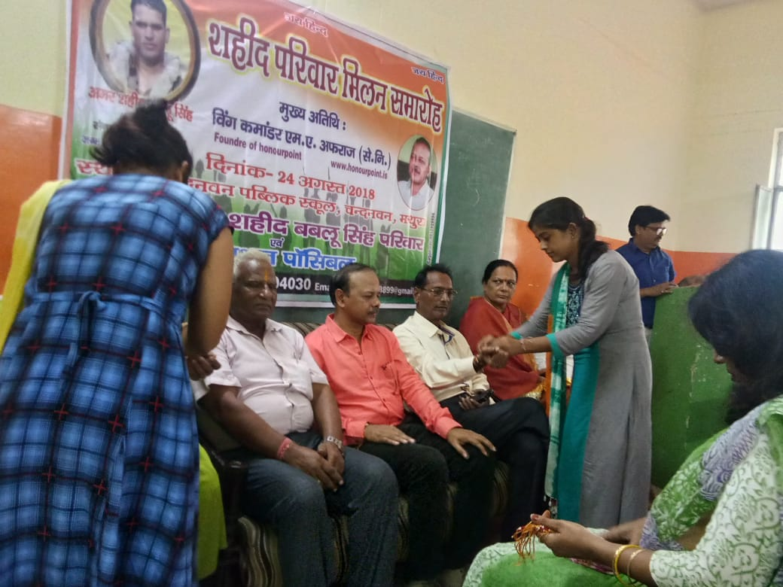
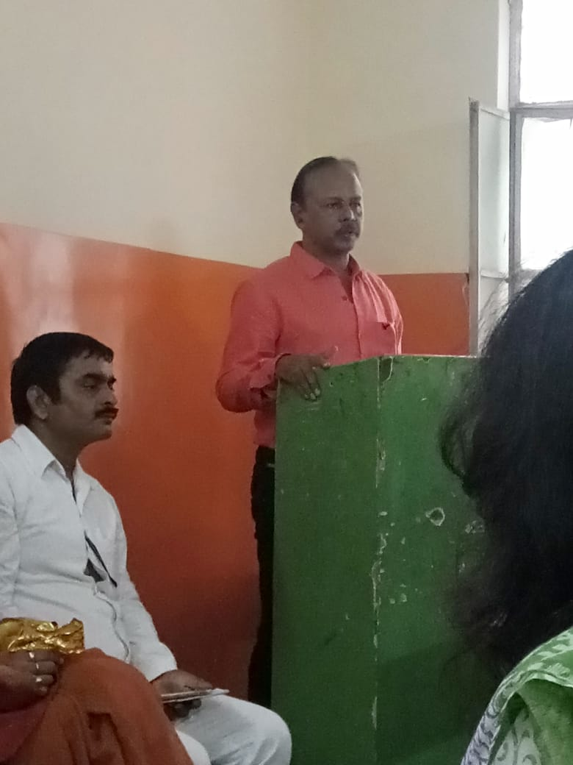
In association with “Mission Possible”, Mathura: Aug 2018

Slide 15
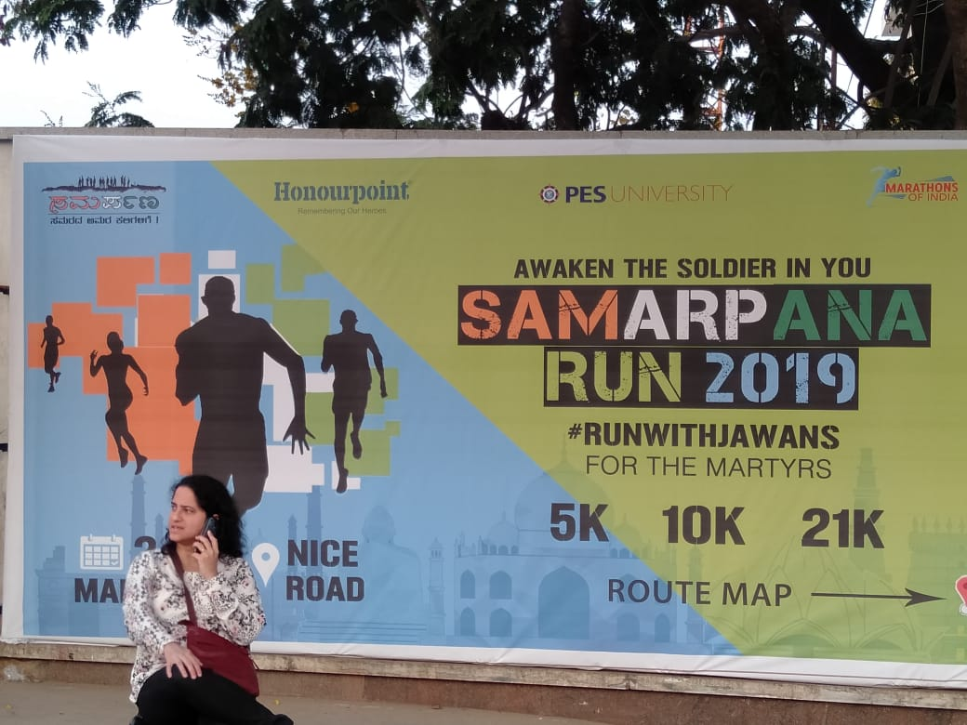
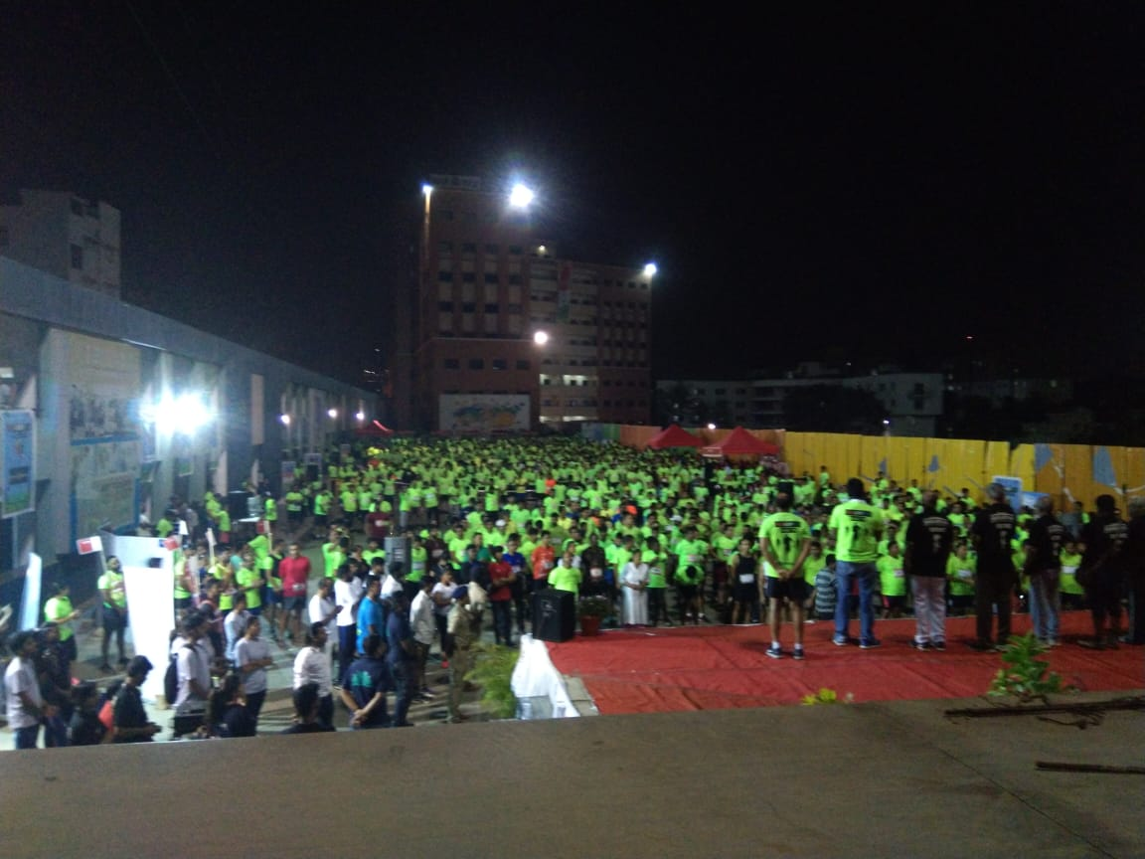
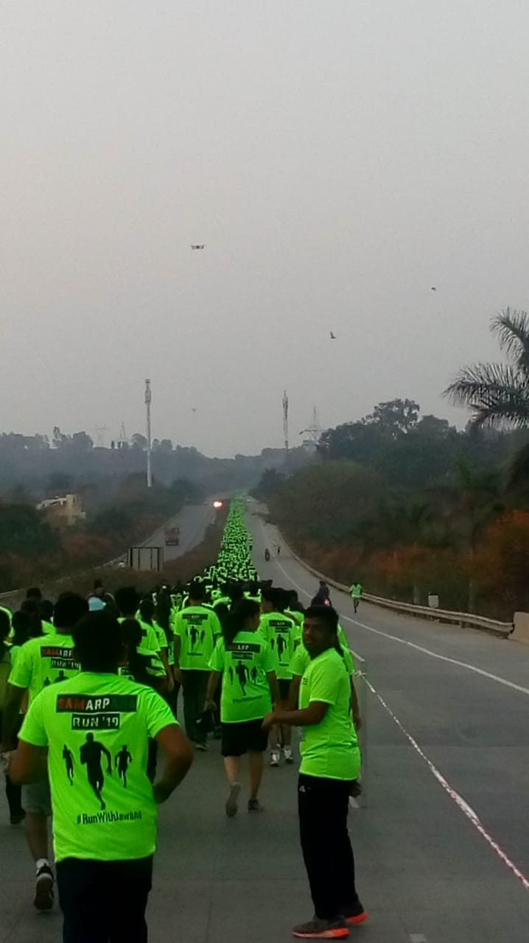
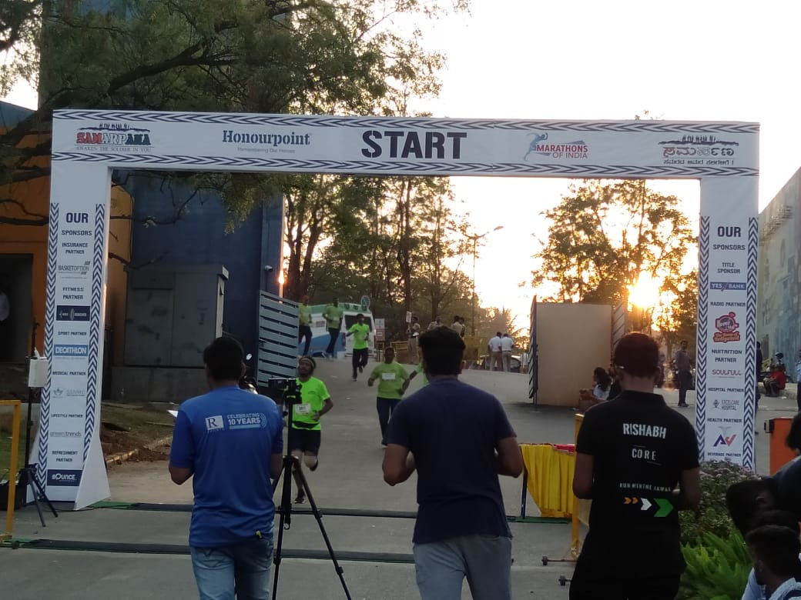
In association with Samarpana Bangalore: 24 Mar 2019

Slide 16
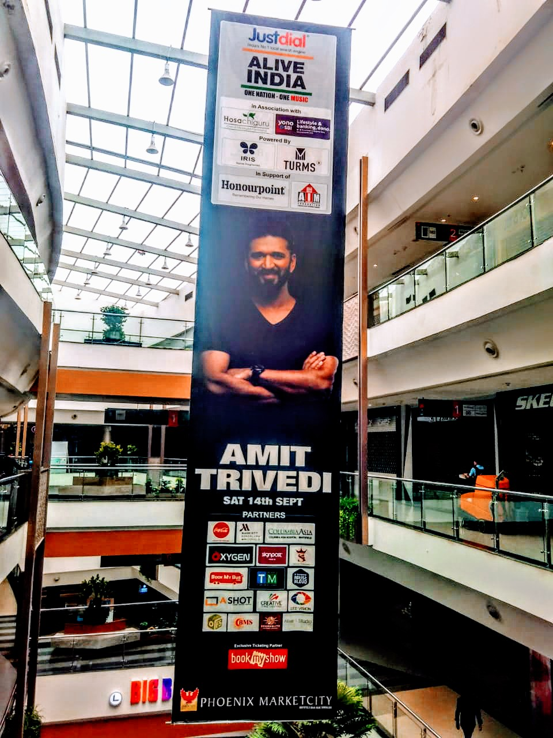


In association with Alive India (Amit Trivedi Show) at Bangalore : 14 Sep 2019

Slide 17
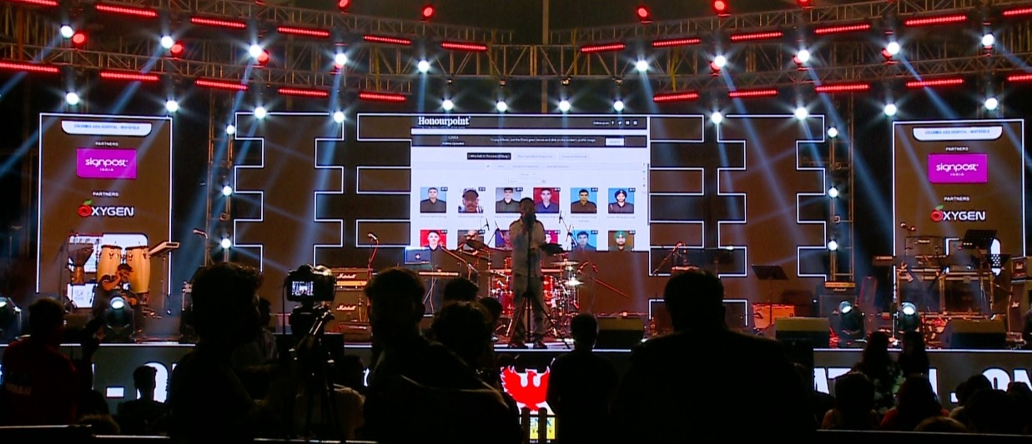

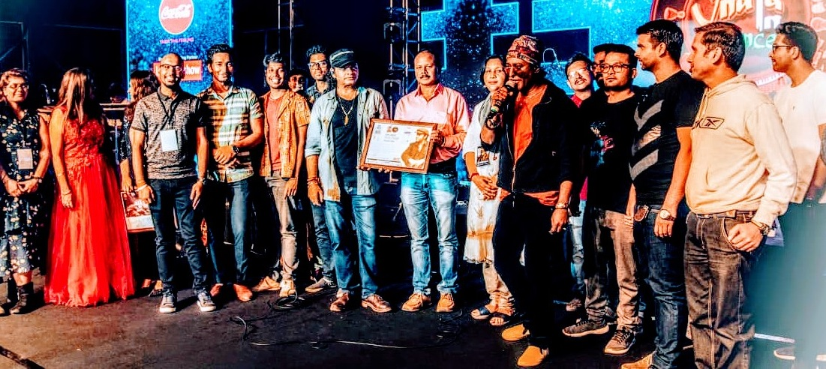
In association with Alive India (Mohit Chauhan Show) at Bangalore :12 Oct 2019

Slide 18
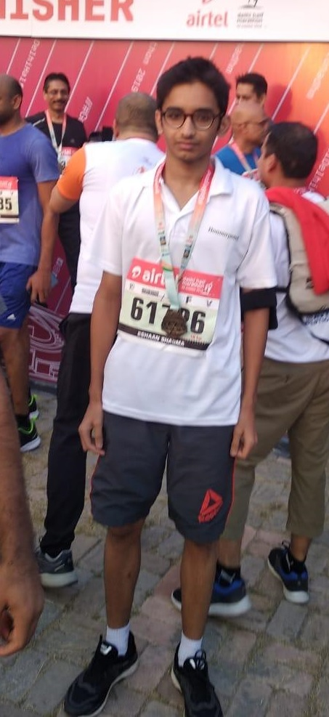
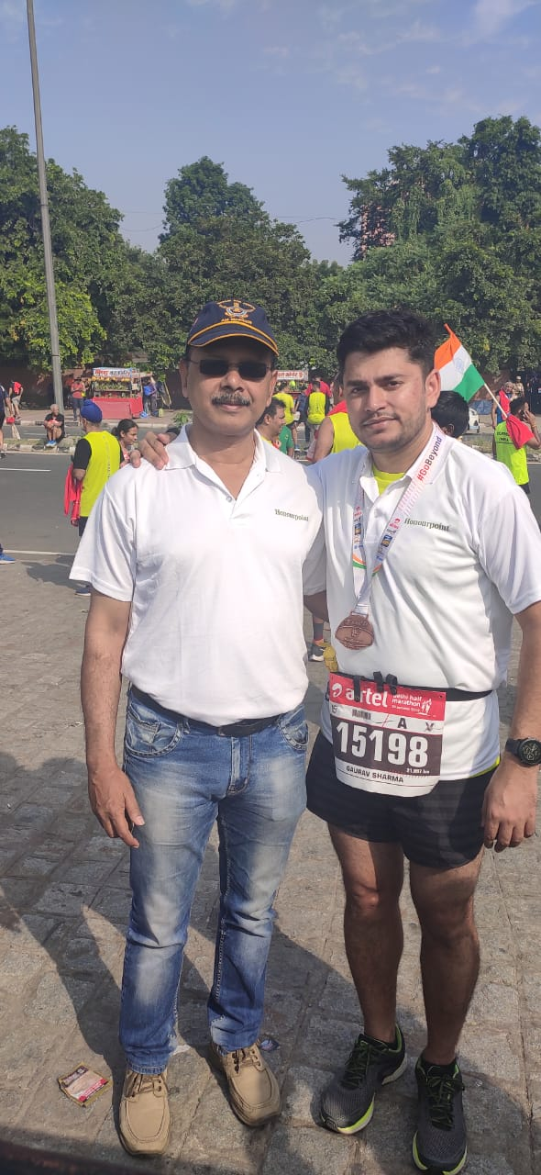
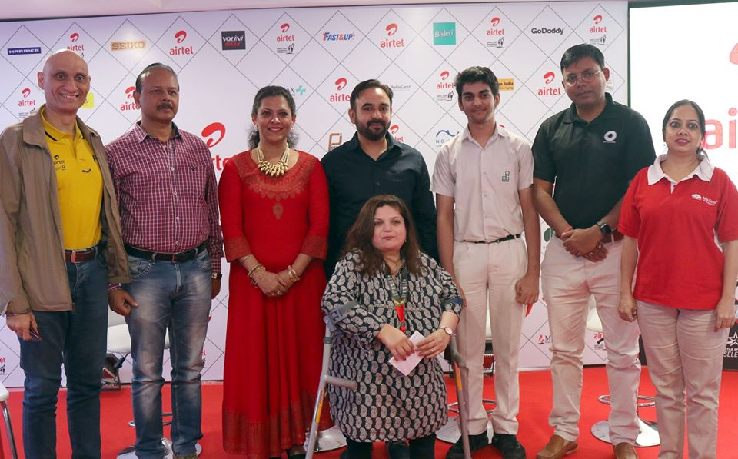
In association with ADHM at Delhi: 20 Oct 2019

Slide 19

TV Serial “Main Shaheed Hun” in association with TV9

Slide 20



Rang De Veer : 26 Jul 2020 to 15 Aug 2020

Slide 21

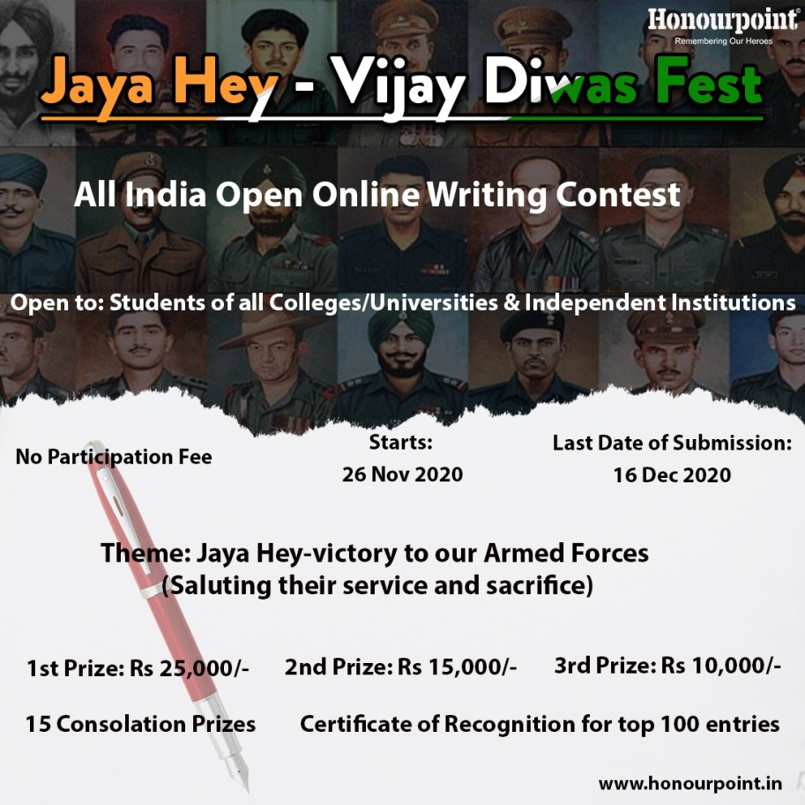

Jay Hey – Vijay Diwas (26 Nov 2020 to 16 Dec 2020)

Slide 22
Recognition
Radio:
Radio Mirchi , Radio Fever 104 FM, Radio Top FM
Digital Platforms: Yourstory.com, thebetterindia.com, thelogicalindian.com, theoptimistindian.com, indiamantra.com
Print:
Hindustan Times, Deccan Chronicle, The Week, The Times of India, The Hindu, Indian Express, Deccan Herald, DNA, Rajasthan Patrika (Hindi), Dainik Navajyoti (Hindi), Mathrubhumi (Malayalam), Eenadu (Kannada), Prajavani (Kannada), Phulchhab(Gujarati), Chitralekha(Gujarati)
Misc:
Recognized as one of the top 10 initiatives of the country for social impact in the National Youth Conference held in Jan 2018

Slide 23
Honourpoint’s Impact
Covered more than
26000 martyrs so far
Has over 610,000 followers on Facebook
Organized 20 programs so far for the benefit of the martyrs’ families in collaboration with other philanthropic organizations (7 in Mumbai, 7 in Bangalore, 2 in Delhi and one each in Surat, Mathura, Jhunjhunu(Raj) and Seoni(Madhya Pradesh)

Slide 24
Core Areas of Activity
Honourpoint puts sustained efforts into three core areas:
Area:1
Building online memorial for the martyrs of Armed Forces since 1947
Area: 2
Creating awareness about the contribution of martyrs and their families to the nation
Area:3
Programs for the benefit of the martyrs’ families in collaboration with various partners

Slide 25

Rang De Veer : 26 Jul 2022 to 15 Aug 2022

Slide 26
“Rang De Veer”—26 Jul 22 to 15 Aug 22
For all children in schools in India and abroad
Two Categories:
(a)Class I to Class VI(up to 12 yrs)
(b)Class VII to Class XII(up to 18 yrs)
Total Prizes: 56 (28 in each category)

Slide 27
“Rang De Veer”—Volunteers’ Support
Objective: create awareness about the event among schools
Schools in India
Govt : 1 million
Govt Aided: 84000
Private: 3,25000
Total students
Govt : 128 million
Govt Aided: 27 million
Private: 83 million
Tot: 220 million(approx)

Slide 28
“Rang De Veer”—Volunteers’ Support
Requirements:
School Principal/Chairman/Administrative Head -- mail I’d/Contact details (verified)
Trustees/Organisation Heads of school chains--mail I’d/Contact details (verified)

Slide 29
“Rang De Veer”—Volunteers’ Support
Requirements:
Share RDV info through Facebook, Instagram/WhatsApp
Share info with schools/parents/alumni groups
Translate into Hindi, Gujarati, Telugu etc to share
Pay tributes on https://www.honourpoint.in/

Slide 30
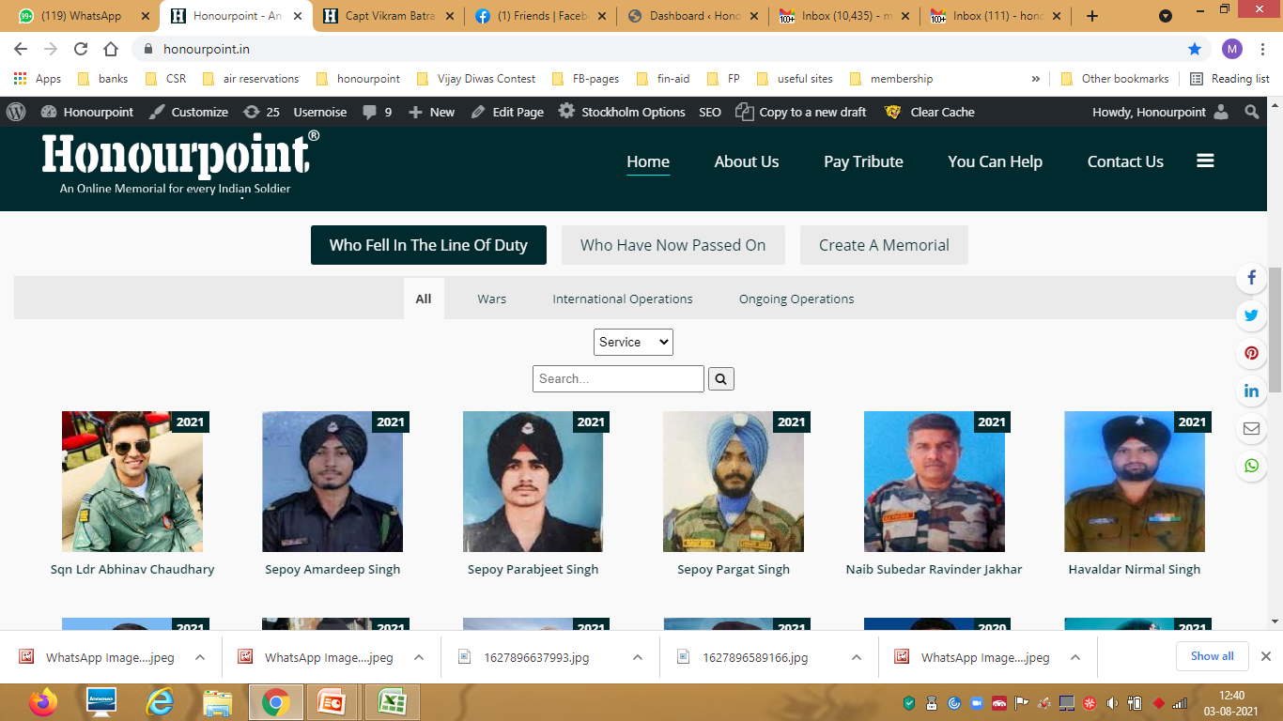
Profile Tabs

Slide 31
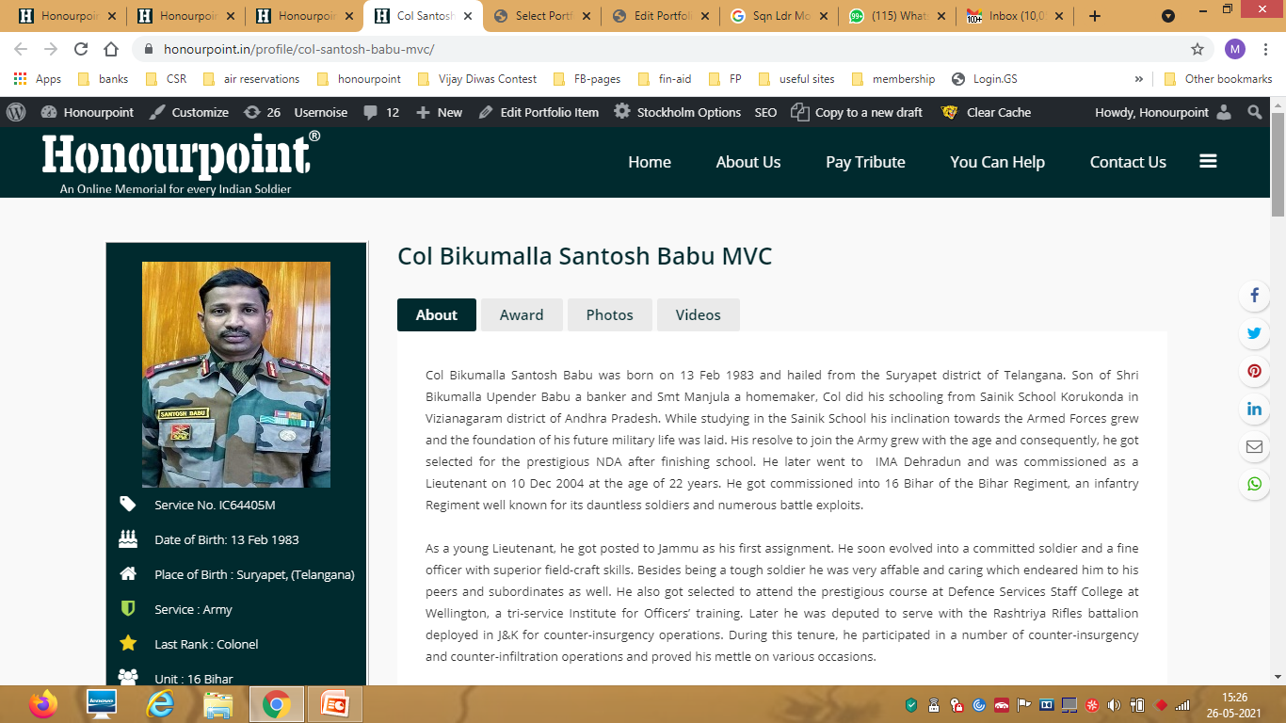
Profile Tabs

Slide 32
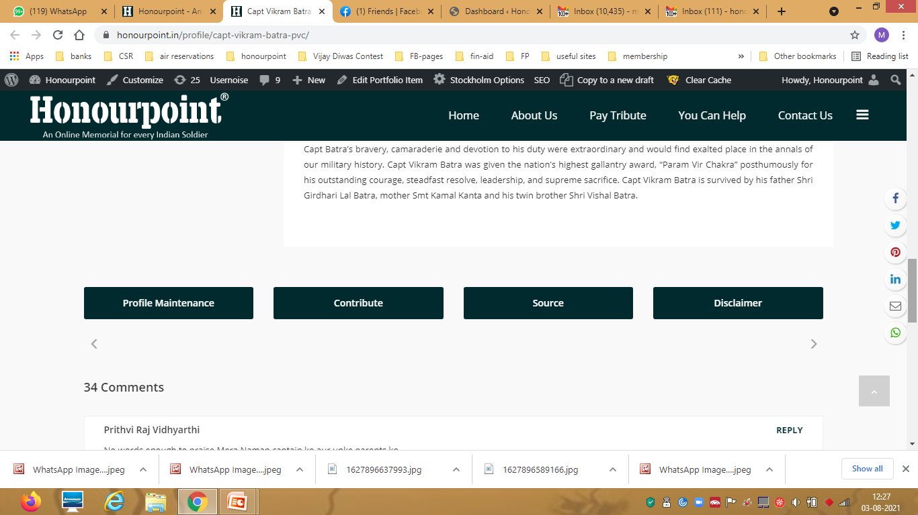
Profile Tabs

Slide 33
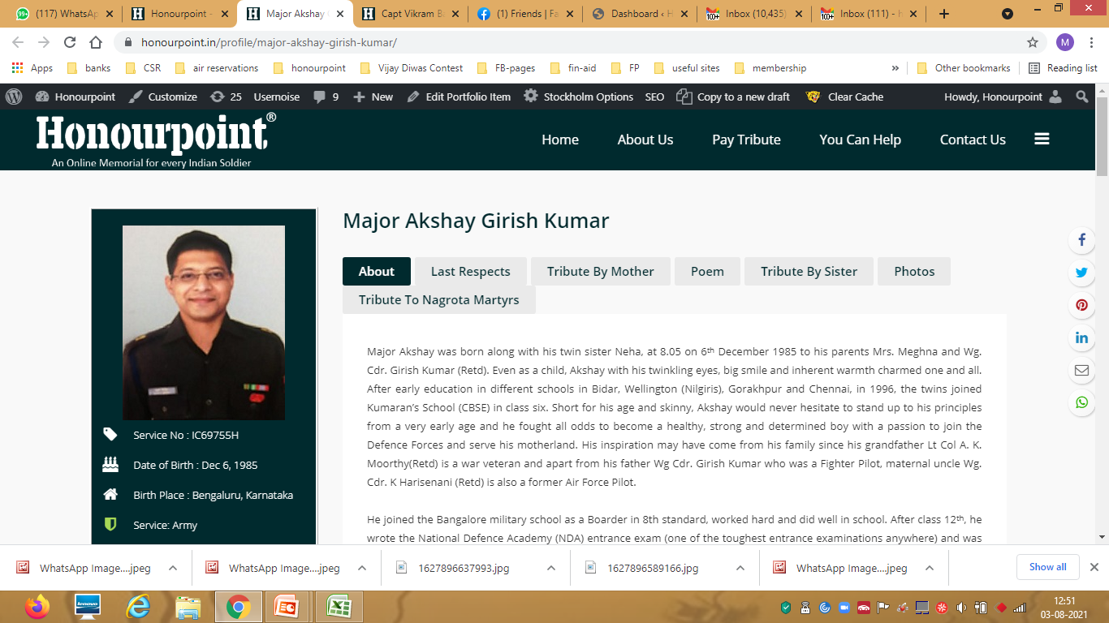
Profile Tabs

Slide 34
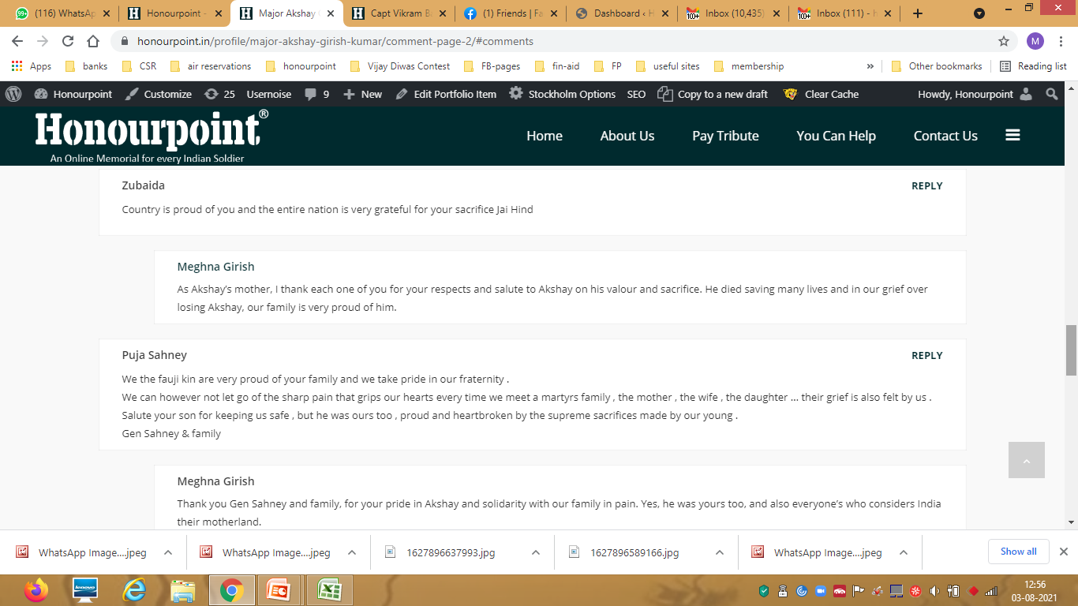
Profile Tabs

Slide 35
“Rang De Veer”—Volunteers’ Support
Requirements:
Connect with local news papers/media/TV
Connect with local FM Radio
Connect with local cultural organisations/clubs/gated communities

Slide 36
“Rang De Veer”—Volunteers’ Support
Salient Points:
Hassle free online contest
Participation from Home
Participation is free with attractive prizes

Slide 37
“Rang De Veer”—Volunteers’ Support
Salient Points:
Can be an organised school activity
Emotional connect with the cause
Added relevance in “Azadi Ka Amrit Mahotsva” being commemorated by the nation

Slide 38
“RDV”—Volunteers’ Support(Process)
Division into Groups(Based on regions/states/tasks)
Collation of data, activity feedback by Group Leads for Team Lead
Team Lead to share information at specified intervals with Honourpoint

Slide 39
“RDV”—Volunteers’ Support(Process)
Total Support Requirement: 6 weeks( Till 31 July)
First 3 weeks(Till 10 July): Focus on school data
Next 3 weeks(Till 31 July): Also Focus on sharing info through various channels

Slide 40
“Rang De Veer”—Volunteers’ Support
Information from Honourpoint:
School chains already contacted
Format for submission
Event details/creatives etc

Slide 41

Thank You

